Slide 1
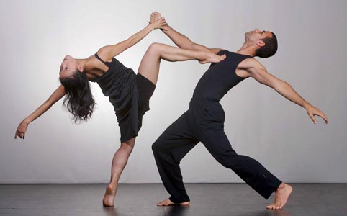

YEAR 9 DANCE
DANCE SKILLS UNIT .

Slide 2
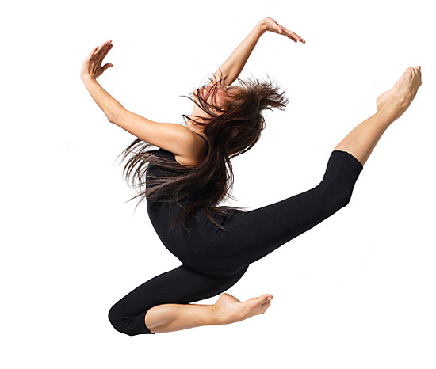
LESSON OBJECTIVE
DEMONSTRATE AN UNDERSTANDING OF THE FOLLOWING KEY WORDS AND HOW TO APPLY THEM INTO YOUR TECHNICAL WARM UP AND ROUTINE:
Core stability
Extensions
Musicality
Fluidity and control of movement
Movement memory

Slide 3
LONG TERM OBJECTIVES
explore and develop your dance skills and review your own practice
use your dance skills within rehearsal and performance.

Slide 4
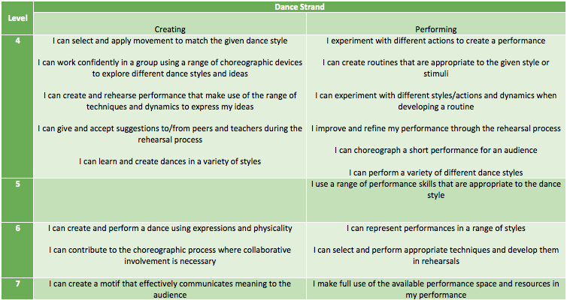
SUCCESS CRITERIA

Slide 5
EXPECTATIONS
YOU WILL NEED TO BE ABLE TO USE YOUR TIME WISELY IN LESSONS.
TURN UP TO LESSONS ON TIME.
NO SOCKS TO BE WORN.
IF YOU DO NOT HAVE YOUR KIT YOU WILL STILL BE EXPECTED TO PARTICIPATE.
REHEARSE AT HOME AND AT SCHOOL.
WORK TO THE BEST OF YOUR ABILITY.
FOLLOW THE TEACHERS INSTRUCTIONS.
APPLY FEEDBACK GIVEN.

Slide 6
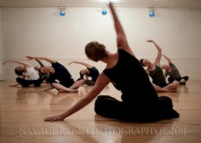
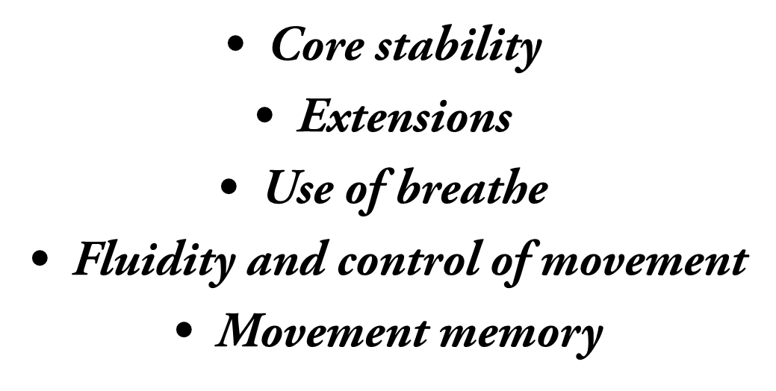
TASK 1
RECAP- WHAT ARE THE COMPONENTS OF A WARM UP?
LEARN A TECHNICAL STREET DANCE WARM UP FOCUSING ON:

Slide 7
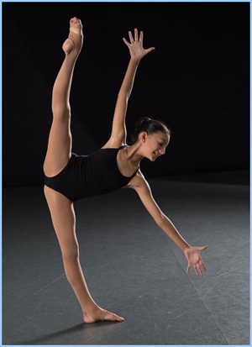
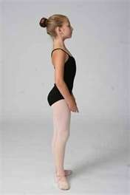
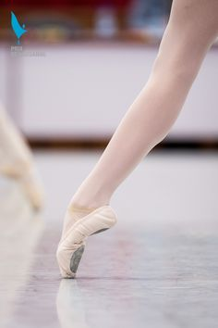
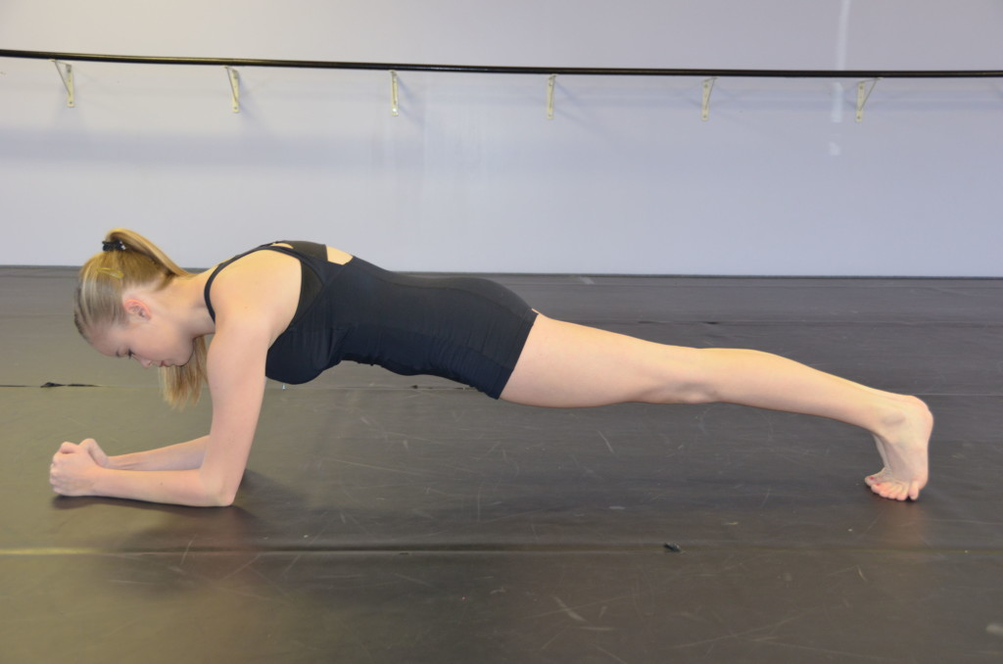
WHEN PERFORMING THINK ABOUT THE FOLLOWING :

Slide 8
KEY WORDS
Musicality
Core stability
Extensions
Fluidity and control of movement
Movement memory

Slide 9
WHAT GRADE ARE YOU AIMING FOR? HOW ARE YOU GOING TO ACHIEVE THIS?

Slide 10
WHAT ARE THE MAIN COMPONENTS OF STREET DANCE
RECAP
CAN YOU REMEMBER WHAT THE KEY COMPONENTS OF STREET DANCE ARE?

Slide 11
LEARN THE OPENING SECTION OF YOUR NEW STREET DANCE ROUTINE

Slide 12
PLENARY
RECAP OF KEY WORDS AND THEIR DEFINITION.
WHAT 3 TARGETS HAVE YOU SET YOURSELF?
WHY IS IT IMPORTANT TO SET TARGETS.

Slide 13
LONG TERM OBJECTIVES
explore and develop your dance skills and review your own practice
use your dance skills within rehearsal and performance.

